Slide 1

COMP7500/7506 Advanced Operating Systems
Disk Scheduling
Dr. Xiao Qin
Auburn University http://www.eng.auburn.edu/~xqin
xqin@auburn.edu

Slide 2
Review: Disk I/O Time
I/O time = seek time + rotational delay + transfer time
+ controller overhead
Exercise 1 (Plickers): For small disk requests, which time dominates disk I/O time (i.e., disk I/O performance bottleneck)?
Seek Time
Rotational Delay
Seek Time + Rotational Delay
Transfer Time

Slide 3
Review: Disk I/O Time
I/O time = seek time + rotational delay + transfer time
+ controller overhead
Exercise 2 (Plickers): For large disk requests, which time dominates disk I/O time (i.e., disk I/O performance bottleneck)?
Seek Time
Rotational Delay
Seek Time + Rotational Delay
Transfer Time

Slide 4
Learning Objectives: Disk Scheduling
1
2
SCAN Scheduling
SSTF Scheduling
3
LOOK Scheduling

Slide 5
Disk Scheduling
Notes:
The operating system is responsible for using hardware efficiently — for the disk drives, this means having a fast access time and disk bandwidth
Minimize seek time
Seek time ≈ seek distance
Disk bandwidth is the total number of bytes transferred, divided by the total time between the first request for service and the completion of the last transfer

Slide 6
Disk Scheduling
Exercise 3 (Plickers): Which time can’t be affected by disk scheduling?
A) Disk I/O Time B) Seek Time
C) Rotational Delay D) Transfer Time
Notes:
The operating system is responsible for using hardware efficiently — for the disk drives, this means having a fast access time and disk bandwidth
Minimize seek time
Seek time ≈ seek distance
Disk bandwidth is the total number of bytes transferred, divided by the total time between the first request for service and the completion of the last transfer

Slide 7
Exercise 4 (Plickers): Disk scheduling algorithms aim to minimize:
A) Disk Controller Overhead
B) Seek Time
C) Rotational Delay
D) Transfer Time

Slide 8
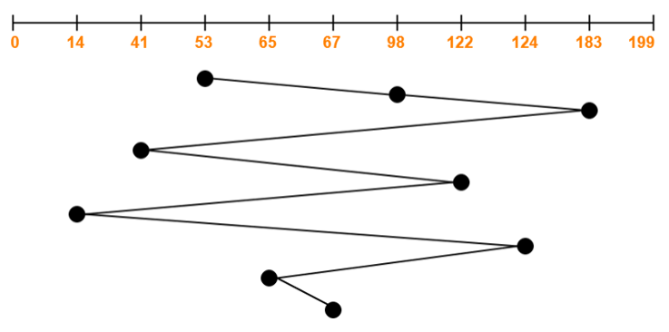
FCFS
A disk queue with I/O requests to blocks on cylinders 98, 183, 41, 122, 14, 124, 65, 67. The head’s initial cylinder: 53. Cylinders in [0, 199].
Total head movements:
(98 – 53) + (183 – 98) + (183 – 41) + (122 – 41) + (122 – 14) + (124 – 14) + (124 – 65) + (67 – 65) = 45 + 85 + 142 + 81 + 108 + 110 + 59 + 2 = 632
Notes:
Reference: https://www.gatevidyalay.com/scan-algorithm-disk-scheduling-algorithms/

Slide 9
Exercise 5 (Plickers): FCFS Queue = 2, 10, 7, 1 Head Start: 8 Total Head Movement A) 23 B) 18 C) 26 D) 35

Slide 10
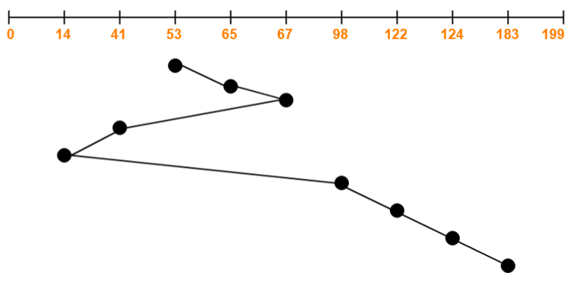
SSTF
A disk queue with I/O requests to blocks on cylinders 98, 183, 41, 122, 14, 124, 65, 67. The head’s initial cylinder: 53. Cylinders in [0, 199].
Pros and Cons?
Total head movements:
(65 – 53) + (67 – 65) + (67 – 41) + (41 – 14) + (98 – 14) + (122 – 98) + (124 – 122) + (183 – 124) = 12 + 2 + 26 + 27 + 84 + 24 + 2 + 59 = 236
Notes:
SSTF stands for Shortest Seek Time First.
This algorithm services that request next which requires least number of head movements from its current position regardless of the direction.
It breaks the tie in the direction of head movement.
Advantages-
It reduces the total seek time as compared to FCFS.
It provides increased throughput.
It provides less average response time and waiting time.
Disadvantages-
There is an overhead of finding out the closest request.
The requests which are far from the head might starve for the CPU.
It provides high variance in response time and waiting time.
Switching the direction of head frequently slows down the algorithm.

Slide 11
Exercise 6 (Plickers): SSTF Queue = 2, 10, 7, 1 Head Start: 8 Total Head Movement A) 10 B) 13 C) 18 D) 21
Notes:
Shortest Service Time First.
Shortest Seek Time First selects the request with the minimum seek time from the current head position
SSTF scheduling is a form of SJF scheduling; may cause starvation of some requests
Illustration shows total head movement of 236 cylinders

Slide 12
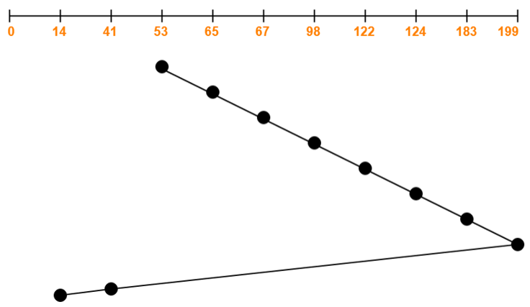
SCAN
A disk queue with I/O requests to blocks on cylinders 98, 183, 41, 122, 14, 124, 65, 67. The head’s initial cylinder: 53. Cylinders in [0, 199].
Pros and Cons?
Total head movements:
= (199 – 53) + (199 – 14)
= 146 + 185
= 331
Notes:
SCAN Disk Scheduling Algorithm-
As the name suggests, this algorithm scans all the cylinders of the disk back and forth.
Head starts from one end of the disk and move towards the other end servicing all the requests in between.
After reaching the other end, head reverses its direction and move towards the starting end servicing all the requests in between.
The same process repeats.
NOTE-
SCAN Algorithm is also called as Elevator Algorithm.
This is because its working resembles the working of an elevator.
Also Read- FCFS Disk Scheduling Algorithm
Advantages-
It is simple, easy to understand and implement.
It does not lead to starvation.
It provides low variance in response time and waiting time.
Disadvantages-
It causes long waiting time for the cylinders just visited by the head.
It causes the head to move till the end of the disk even if there are no requests to be serviced.

Slide 13
Exercise 7: SCAN Queue = 2, 10, 7, 1 Head Start: 8 What is the total disk head movement? What is the assumption?
Notes:
The disk arm starts at one end of the disk, and moves toward the other end, servicing requests until it gets to the other end of the disk, where the head movement is reversed and servicing continues.
SCAN algorithm Sometimes called the elevator algorithm
Illustration shows total head movement of 208 cylinders
But note that if requests are uniformly dense, largest density at other end of disk and those wait the longest
Assumption: 10 is the maximal cylinder.

Slide 14
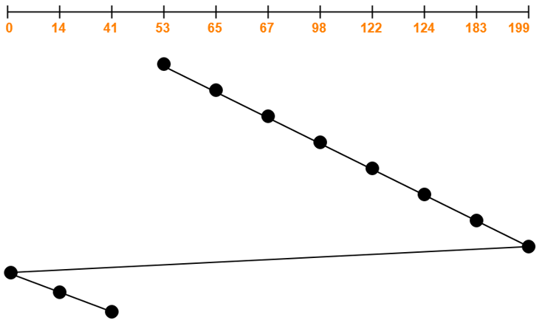
C-SCAN
A disk queue with I/O requests to blocks on cylinders 98, 183, 41, 122, 14, 124, 65, 67. The head’s initial cylinder: 53. Cylinders in [0, 199].
Total head movements:
= (199 – 53) + (199 – 0) + (41 – 0)
= 146 + 199 + 41
= 386
Notes:
SCAN Disk Scheduling Algorithm-
As the name suggests, this algorithm scans all the cylinders of the disk back and forth.
Head starts from one end of the disk and move towards the other end servicing all the requests in between.
After reaching the other end, head reverses its direction and move towards the starting end servicing all the requests in between.
The same process repeats.
NOTE-
SCAN Algorithm is also called as Elevator Algorithm.
This is because its working resembles the working of an elevator.
Also Read- FCFS Disk Scheduling Algorithm
Advantages-
It is simple, easy to understand and implement.
It does not lead to starvation.
It provides low variance in response time and waiting time.
Disadvantages-
It causes long waiting time for the cylinders just visited by the head.
It causes the head to move till the end of the disk even if there are no requests to be serviced.

Slide 15
Exercise 8: C-SCAN Queue = 2, 10, 7, 1 Head Start: 8 What is the total disk head movement?
Notes:
Provides a more uniform wait time than SCAN
The head moves from one end of the disk to the other, servicing requests as it goes
When it reaches the other end, however, it immediately returns to the beginning of the disk, without servicing any requests on the return trip
Treats the cylinders as a circular list that wraps around from the last cylinder to the first one
Total number of cylinders?

Slide 16
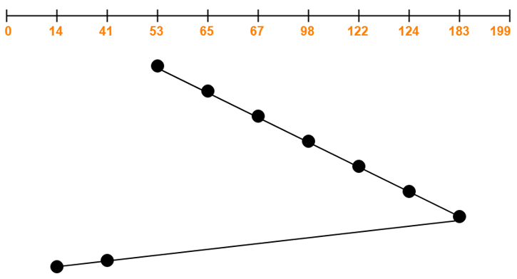
LOOK
A disk queue with I/O requests to blocks on cylinders 98, 183, 41, 122, 14, 124, 65, 67. The head’s initial cylinder: 53. Cylinders in [0, 199].
Total head movements:
= (183 – 53) + (183 – 14)
= 130 + 169
= 299
Notes:
LOOK Disk Scheduling Algorithm-
LOOK Algorithm is an improved version of the SCAN Algorithm.
Head starts from the first request at one end of the disk and moves towards the last request at the other end servicing all the requests in between.
After reaching the last request at the other end, head reverses its direction.
It then returns to the first request at the starting end servicing all the requests in between.
The same process repeats.
Also Read- C-SCAN Disk Scheduling Algorithm
NOTE-
The main difference between SCAN Algorithm and LOOK Algorithm is-
SCAN Algorithm scans all the cylinders of the disk starting from one end to the other end even if there are no requests at the ends.
LOOK Algorithm scans all the cylinders of the disk starting from the first request at one end to the last request at the other end.
Advantages-
It does not causes the head to move till the ends of the disk when there are no requests to be serviced.
It provides better performance as compared to SCAN Algorithm.
It does not lead to starvation.
It provides low variance in response time and waiting time.
Disadvantages-
There is an overhead of finding the end requests.
It causes long waiting time for the cylinders just visited by the head.

Slide 17
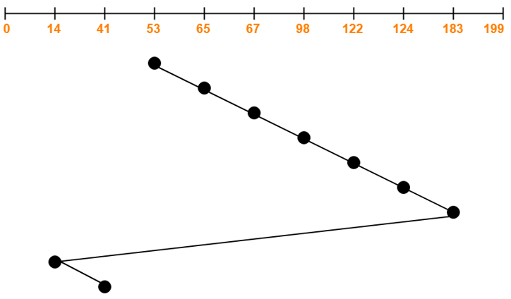
C-LOOK
A disk queue with I/O requests to blocks on cylinders 98, 183, 41, 122, 14, 124, 65, 67. The head’s initial cylinder: 53. Cylinders in [0, 199].
Total head movements:
= (183 – 53) + (183 – 14) + (41 – 14)
= 130 + 169 + 27
= 326
Notes:
C-LOOK Disk Scheduling Algorithm-
Circular-LOOK Algorithm is an improved version of the LOOK Algorithm.
Head starts from the first request at one end of the disk and moves towards the last request at the other end servicing all the requests in between.
After reaching the last request at the other end, head reverses its direction.
It then returns to the first request at the starting end without servicing any request in between.
The same process repeats.
Also Read- SCAN Disk Scheduling Algorithm
Advantages-
It does not causes the head to move till the ends of the disk when there are no requests to be serviced.
It reduces the waiting time for the cylinders just visited by the head.
It provides better performance as compared to LOOK Algorithm.
It does not lead to starvation.
It provides low variance in response time and waiting time.
Disadvantages-
There is an overhead of finding the end requests.

Slide 18
Exercise 9: Which is LOOK and which is C-LOOK?

Slide 19

Summary
What is the SSTF algorithm?
What is the SCAN algorithm?
What is the C-SCAN algorithm?
What is the LOOK algorithm?
What is the C-LOOK algorithm?
Reading Assignment:
Chapter 10.4 pp. 472-478

Slide 20
What’s Next?
The LOOK algorithm
RAID Structures
Reading Assignment:
Chapter 10.7 pp. 484-492.

